Slide 1
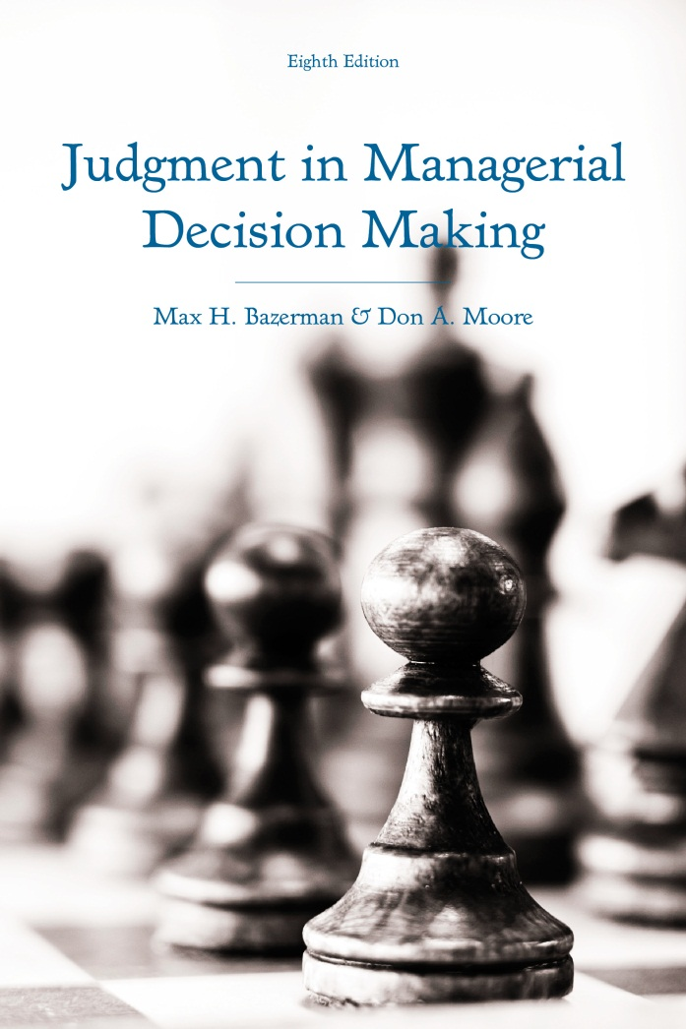
Judgment in Managerial Decision Making 8e
Chapter 2
Overconfidence
Copyright 2013 John Wiley & Sons

Slide 2
Write Your 98% Confidence Intervals
Point Estimate | Lower Estimate | Upper Estimate
 |  |  | Wal-Mart’s 2010 revenue
 |  |  | Google’s 2010 revenue
 |  |  | World population (as of January 2012)
 |  |  | 2012 US GDP
 |  |  | Population of China (as of December 2011)
 |  |  | Rank of McDonald’s in 2010 Fortune 500
 |  |  | Rank of General Electric in 2010 Fortune 500
 |  |  | The national debt of Greece (as of December 2011, in Euros)
Notes:
Please take five minutes to provide your best estimate of each quantity specified to the right and an interval for which you are 98% confident that the truth falls.
In constructing your confidence intervals, provide a lower estimate that represents the lowest end of the 98% confidence interval and an upper estimate that represents the highest end of the 98% confidence interval.
Write your responses down on a piece of paper. We will return to your answers shortly.

Slide 3
The Mother of All Biases
Overconfidence is considered robust
Some consequences of overconfidence:
  Wars
  Stock market bubbles
  Strikes
  Unnecessary lawsuits
  High rates of entrepreneurial failure
  Failure of mergers and acquisitions
Notes:
Some scholars have declared overconfidence to be the “most robust finding in the psychology of judgment”.
Overconfidence is not only considered to be robust, but it is also considered to be responsible for many adverse outcomes, such as:
Wars
Stock market bubbles
Strikes
Unnecessary lawsuits
High rates of entrepreneurial failure
Merger and acquisition failure

Slide 4
Three Forms of Overconfidence
Overprecision | Overestimation | Overplacement
Being too certain that you know the truth. Excessive certainty in our accuracy Lack of interest in testing assumptions Dismissing evidence suggesting we’re incorrect Overly narrow confidence intervals | Thinking you are better than you really are. Overestimating your productivity Overestimating your control Overestimating your test scores Overestimating your attractiveness | Falsely thinking that you are better than others. Negotiating with superior others Representing yourself in court Entering a prestigious competition Founding a start-up
Notes:
There are three forms of overconfidence:
Overprecision
Overestimatiopn
Overplacement
Overprecision is being too certain that you know the truth. Examples:
Being overly certain that your estimates are accurate.
Lacking interest in testing the veracity of your own assumptions.
Dismissing evidence suggesting that our estimates are incorrect.
Giving overly narrow confidence intervals around your own estimates.
Overestimation is the belief that you are better at something than you really are. Examples:
Overestimating how many pages you will write in an hour.
Overestimating the amount of control that you have over a situation.
Overestimating how well you scored on the GMAT.
Overestimating how attractive you are to others.
Overplacement is the false belief that you are better than others. Examples:
Negotiating against a superior opponent.
Representing yourself in court against an experienced attorney.
Paying to enter a competition with experienced and qualified competitors.
Founding a start-up company and competing for venture capital funding.

Slide 5
Are You Overprecise?
Point Estimate
$421 billion | Wal-Mart’s 2010 revenue
$29 billion | Google’s 2010 revenue
7 billion | World population (as of January 2012)
$15 trillion | 2012 US GDP
$1.3 billion | Population of China (as of December 2011)
108 | Rank of McDonald’s in 2010 Fortune 500
4 | Rank of General Electric in 2010 Fortune 500
€341 billion | The national debt of Greece (as of December 2011, in Euros)
Notes:
Now, return to your 98% confidence interval estimates that you gave at the beginning of the lecture. Mark whether the true estimates given here fall within your 98% confidence intervals.
If you are accurate, 7-8 of your confidence intervals should have contained the true value.
However, most people only use the right confidence interval for 2-6 of these quantities.
This is evidence that most of us are overprecise in our beliefs about our own accuracy.

Slide 6
What Causes Overprecision?
Lacking knowledge about a topic
We are rewarded for overprecision
We don’t seek contradictory evidence
Notes:
There are several factors that enhance the likelihood of overprecision.
When we lack knowledge about a topic, we often exhibit more overprecision.
Experts are often less overprecise than novices, so gaining expertise in a domain is one way that we can combat the tendency to be overprecise in our judgments related to that domain.
Advisors who express the most certainty are often the most trusted and viewed the most favorably. As a result, we tend to learn over time that by expressing certainty to others, they will view us as possessing more expertise and competence. Unfortunately, when this spills over into our own private decision-making, it can lead to magnified overprecision.
A bias known as the confirmation bias, which will be discussed later on in the course, is also responsible for our overprecise judgments. We often seek information that confirms our prior beliefs and this tends to make us more overprecise. However, if we make an effort to consider information that disconfirms our prior beliefs, we can combat the tendency to be overprecise.
People who average two estimates together tend to be more accurate than people who only provide one estimate of a quantity.
Simply forcing people to consider alternative outcomes makes them more accurate.

Slide 7
Consequences of Overprecision
Ignoring feedback from others
Active portfolio management
Spending hours interviewing job candidates
Notes:
Consequences of overprecision include:
We tend to ignore feedback from others suggesting that our judgment is biased.
When we learn what other people estimated after making our own estimates, we adjust to their estimates, but we overweight our own prior estimates when adjusting.
If we were truly unbiased, we would equally weight our own opinion with those of others on average.
Being excessively certain that you can estimate the future value of a financial asset leads to excessive trading in financial markets.
The more investors trade, the less worse they fare economically.
On average, most investors experience portfolio turnover, which leads to them faring worse than they would have if maintaining a passively managed index fund.
Managers are often excessively certain about their ability to detect job applicants who will be successful working for them.
This belief leads to them spending many hours in interviews trying to get a read on job candidates.
However, traditional face-to-face interviews are known to be horrible predictors of future performance while simpler tools such as IQ tests can tell us more about a candidate’s capacity to perform well in the future.
Abandoning face-to-face interviews in favor of more simple diagnostic tools may save managers valuable time.

Slide 8
Consequences of Overestimation
Self-enhancement
The illusion of control
The planning fallacy
Optimistic biases
Notes:
Overestimation, the belief that one is better at something than he or she really is, has several notable consequences:
Self-enhancement, or the tendency to view ourselves positively as opposed to accurately.
We tend to believe that the groups to which we belong are superior to others.
We like the letters in our names more than other letters.
We value items that we possess more than items we do not possess.
We overestimate our performance, abilities, and talents.
We evaluate ourselves more positively on desirable traits than on less desirable traits.
We exhibit the planning fallacy, the tendency to overestimate the speed at which we can complete projects and tasks.
Major construction projects almost always take longer than planned.
The majority of software development projects exceed deadline and budgetary constraints.
We become less likely to exhibit the planning fallacy when complications are minimized. In fact, on very simple tasks, we actually tend to overestimate our completion times.
We tend to be overly optimistic about our future outcomes.
Though we like to savor the prospect of a promising future, we don’t always display this tendency.
Sometimes, we engage in defensive pessimism so that we are not disappointed when a desired future outcomes does not come true.
People who are the most optimistic about their abilities tend to be the most disappointed by their outcomes.
Just before receiving performance feedback, we often reduce our performance expectations in order to lower the likelihood that we are disappointed by falling short of our expectations.

Slide 9
Consequences of Overplacement
Inflated expectations of success
Excessive legal costs
Over-entry into markets
Mergers and acquisitions
Choosing the wrong occupations
Notes:
Overplacement is the tendency to falsely believe that we are better than others.
We tend to overplace on easy tasks and underplace on hard tasks.
However, overplacement on easy tasks is particularly problematic:
When we believe that we are more deserving of others, we often inflate our expectations of success in lawsuits and court battles.
Often, this leads to us carrying out extended court battles with high legal fees that have a low probability of success.
Entrepreneurs tend to overestimate their relative skill, which leads to them entering markets in which they are incapable of competing with existing firms.
CEOs who believe that they are better at creating value for other firms than their current CEO tend to undertake costly mergers and acquisitions that are likely to fail.
We often choose careers on the basis of thinking that we are exceptionally talented at the skills required of a certain occupation. However, while we may be better than most people, we often do not adequately account for the fact that we will be competing against a select group of others who are also extremely talented and in many cases better than ourselves.

Slide 10
Well-Calibrated Decision-Making
Do positive illusions have benefits?
Adverse effects of positive illusions:
  Conflict
  Over-claiming credit
  Inability to learn from mistakes
  Dishonest behavior
  Hits to our credibility
  Less effort on tasks
Notes:
Many argue that positive illusions, despite being biased, are beneficial:
Positive illusions help our self-esteem, resilience and commitment in the face of adversity.
Positive illusions are beneficial to our physical and mental health.
Positive illusions allow us to feel in control of situations.
When we convey positive illusions to others, we are more persuasive.
However, positive illusions lead to biased decision-making, which has a series of consequences:
We often engage in unnecessary conflict as the result of overconfidence and discontent results.
We often believe that we contributed more to a project than we actually did.
We often blame failure factors other than our own biased decision-making, which makes us unlikely to learn from our mistakes.
Overconfidence can lead to us cheating on tasks because we are better at justifying our behavior to ourselves when we believe that we are superior to others.
Though expressing confidence to others can benefit us socially, we lose credibility the moment that our confidence is exposed as overconfidence.
When we believe that we are good at a task, we often fail to adequately prepare, which can ultimately undermine our performance.

